Slide 1

Section 7.3 Trigonometric Substitution
Lecture 2
Main Cases

Slide 2
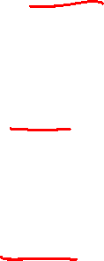
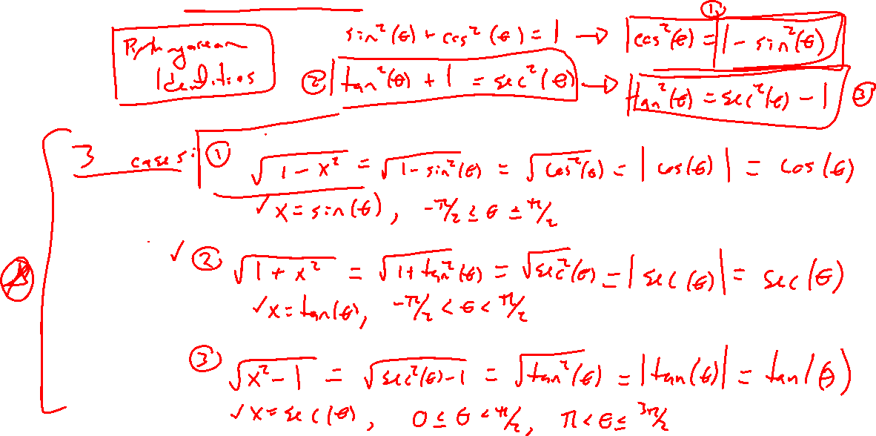
Recap: Pythagoras and Trig Substitution
Notes:
3 main cases, domain restriction is key.
Use everywhere see these terms (to any power)
Not always this obvious

Slide 3
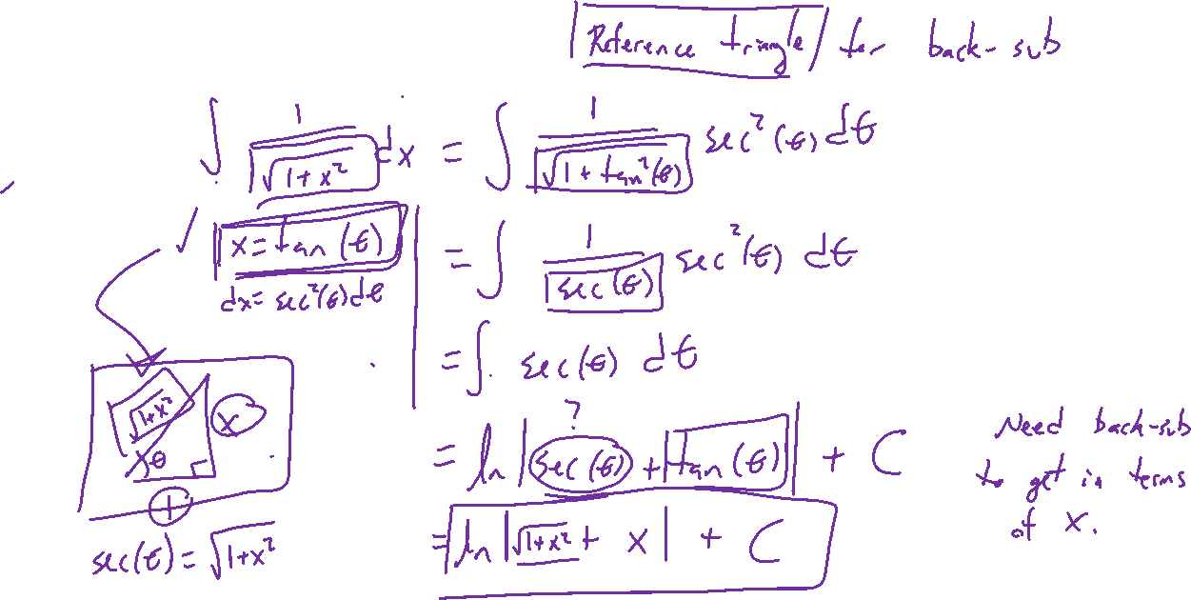
Example: Try on Own
Notes:
\int \frac{1}{\sqrt{1+x^2}} ~dx
Back sub trickier, need reference triangle

Slide 4
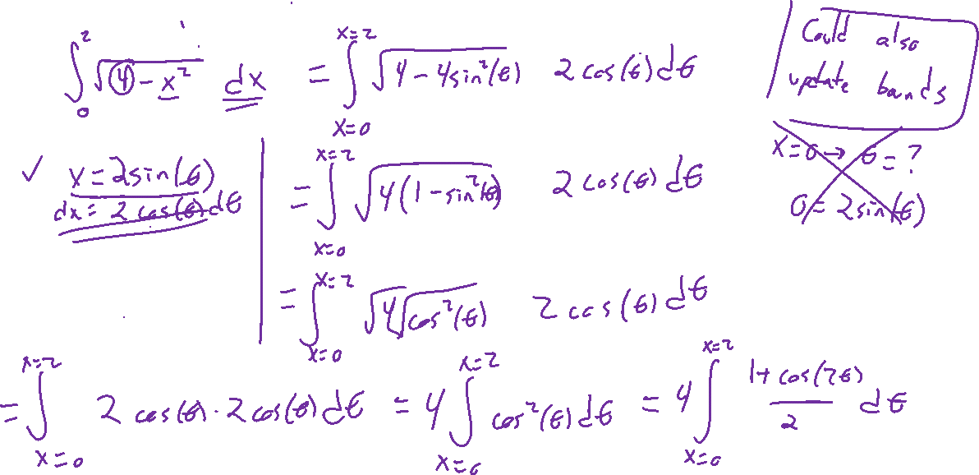
Example: Try on Own
Notes:
Hard to get started: \int \sqrt{4-x^2} ~dx
What should we substitute?

Slide 5
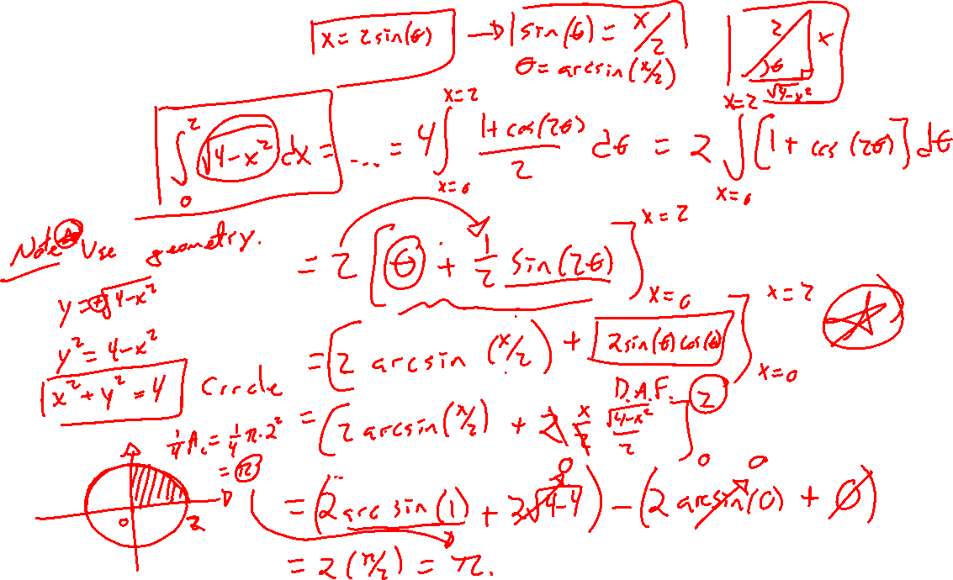
Bonus slide

Slide 6
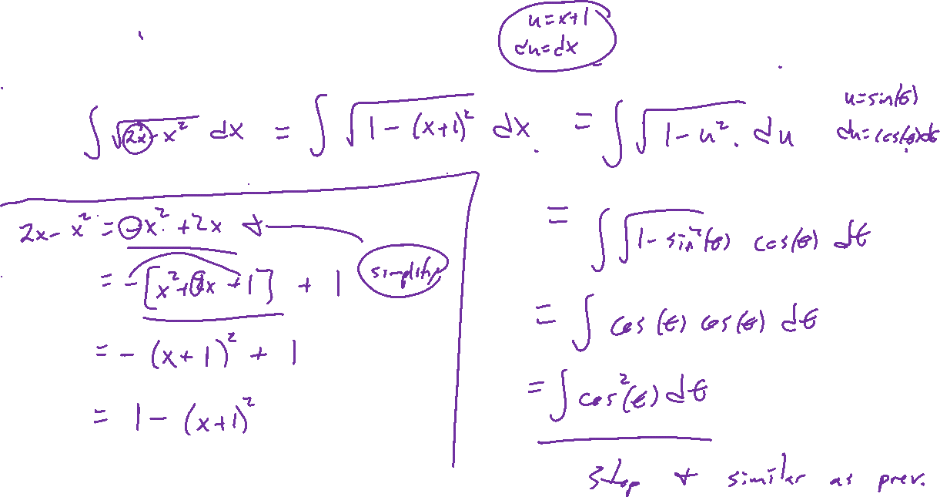
Example: Try on Own
Notes:
Complete the square
\int \sqrt{2x-x^2} ~dx
https://en.wikipedia.org/wiki/Completing_the_square

Slide 7
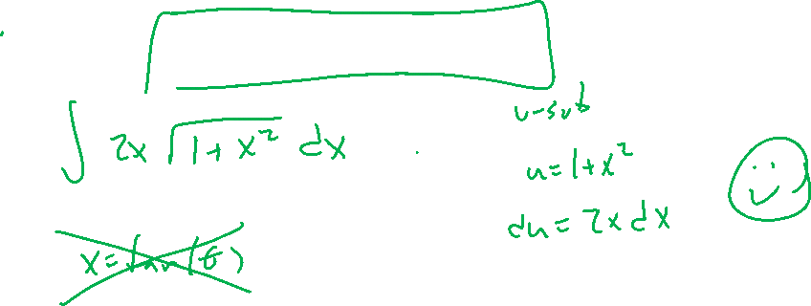
Example: Simpler is Better
Notes:
\int 2x\sqrt{1+x^2}~dx

